Slide 1
Collections

Slide 2
Objectives
Discuss the following topics:
Stacks
Queues

Slide 3
Stacks
A stack is a linear data structure that can be accessed only at one of its ends for storing and retrieving data
A stack is called an LIFO structure: last in/first out

Slide 4
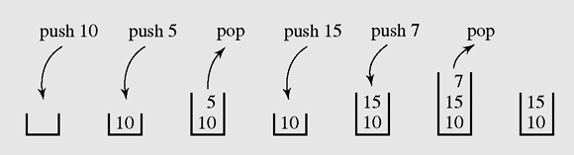
Stacks (continued)
A series of operations executed on a stack

Slide 5
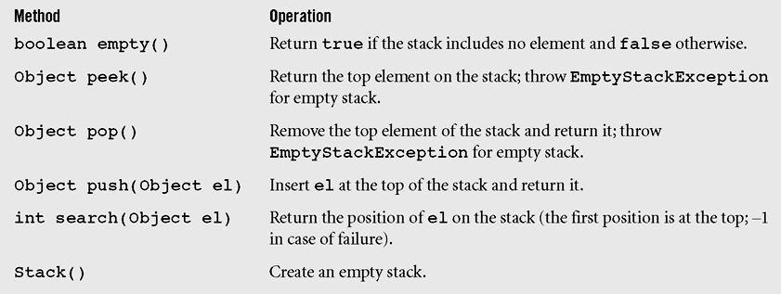
Stacks in java.util
Object get(int index) Returns the element at the specified position in the stack

Slide 6
Example
Stack<String> s = new Stack<String>();
s.push("a");
s.push("b");
s.push("c"); // bottom ["a", "b", "c"] top
System.out.println(s.pop()); // "c"

Slide 7
Collections of primitives
The type parameter specified when creating a collection (e.g. ArrayList, Stack, Queue) must be an object type
// illegal -- int cannot be a type parameter
Stack<int> s = new Stack<int>();
ArrayList<int> list = new ArrayList<int>();
Primitive types need to be "wrapped" in objects
// creates a stack of ints
Stack<Integer> s = new Stack<Integer>();

Slide 8
Wrapper classes
Primitive Type | Wrapper Type
int | Integer
double | Double
char | Character
boolean | Boolean
Wrapper objects have a single field of a primitive type
The collection can be used with familiar primitives:
ArrayList<Double> grades = new ArrayList<Double>();
grades.add(3.2);
grades.add(2.7);
...
double myGrade = grades.get(0);

Slide 9
Stack (continued)
you can pull elements out of the stack one at a time.
common idiom: Pop each element until the stack is empty.
while (!s.isEmpty()) {
s.pop();
}

Slide 10
Queues
A queue is a waiting line that grows by adding elements to its end and shrinks by taking elements from its front
A queue is a structure in which both ends are used:
One for adding new elements
One for removing them
A queue is an FIFO structure: first in/first out

Slide 11
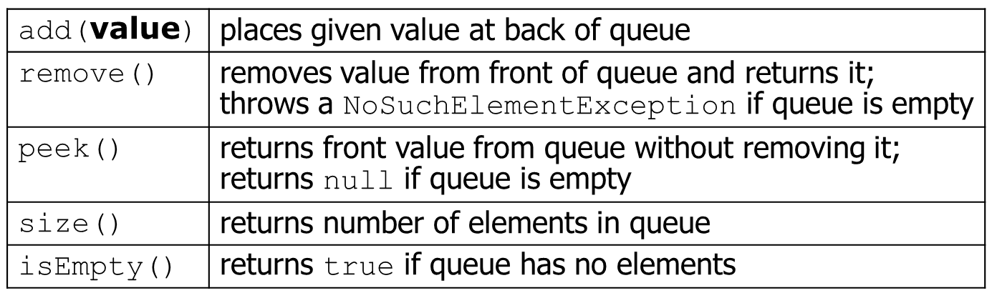
Queues (continued)

Slide 12
Programming with Queues
Queue<Integer> q = new LinkedList<Integer>();
q.add(42);
q.add(-3);
q.add(17); // front [42, -3, 17] back
System.out.println(q.remove()); // 42
IMPORTANT: When constructing a queue you must use a new LinkedList object instead of a new Queue object.

Slide 13
As with stacks, you can pull contents out of queue.
while (!q.isEmpty()) {
q.remove();
}
int size = q.size();
for (int i = 0; i < size; i++) {
q.remove();
}

